Slide 1
Timesheet Database Management System Using Indexes and joins
CS5600 Advanced DataBase Management Systems
Spring 2017
By
Group:SAL
Team
Anusha Chanumolu - 700654648
Lalitha Madhuri Putachala - 700657631
Srividya Gundarapu - 700658410

Slide 2
Overview
Aim
How it is used ?
Implementation Environment
Table Definitions
Test Plans
Temporary Results

Slide 3
Introduction
The purpose of this project is to develop a Database Management System for the Office at University of Central Missouri.
This DBMS tool aids the Office to trace and manage the employee working hours in a certain period of time.

Slide 4
Motivation and Technologies
It Requires an Efficient Database system to log their timesheet.
We have used MySQL for Database.
JAVA (GUI using Java Swings)
We have included Different Modules.

Slide 5
Relational Database Design

Slide 6
Creating table for Student_employee
CREATE TABLE `student_employee` (
`uid` int(11) NOT NULL DEFAULT '0',
`First_Name` varchar(20) DEFAULT NULL,
`Last_Name` varchar(20) DEFAULT NULL,
`Middle_Name` varchar(20) DEFAULT NULL,
`SSN` int(9) NOT NULL DEFAULT '0',
`Position_id` varchar(2) DEFAULT NULL,
`Regular_Max_Hours` int(11) DEFAULT NULL,
`Break_Max_Hours` int(11) DEFAULT NULL,
`Department` varchar(15) DEFAULT NULL,
`join_Date` date DEFAULT NULL,
PRIMARY KEY (`uid`,`SSN`))

Slide 7
Created table and checking the Constraints in the below slide. We are taking two tables to analyse all the scenarios of creating indexes and joins.

Slide 8
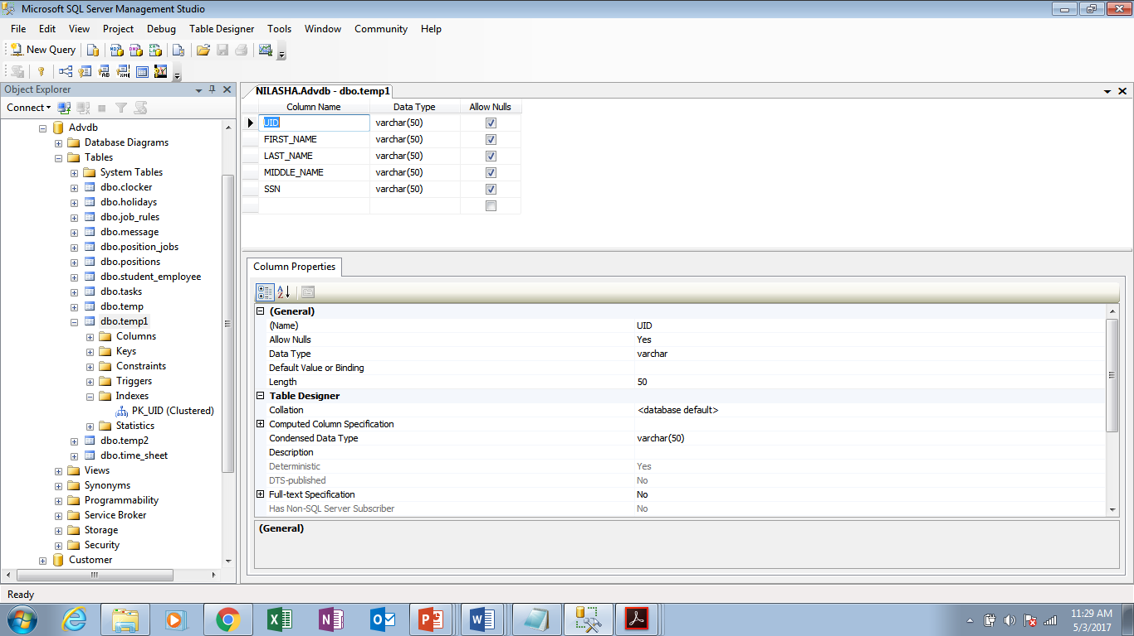
Created Table :

Slide 9
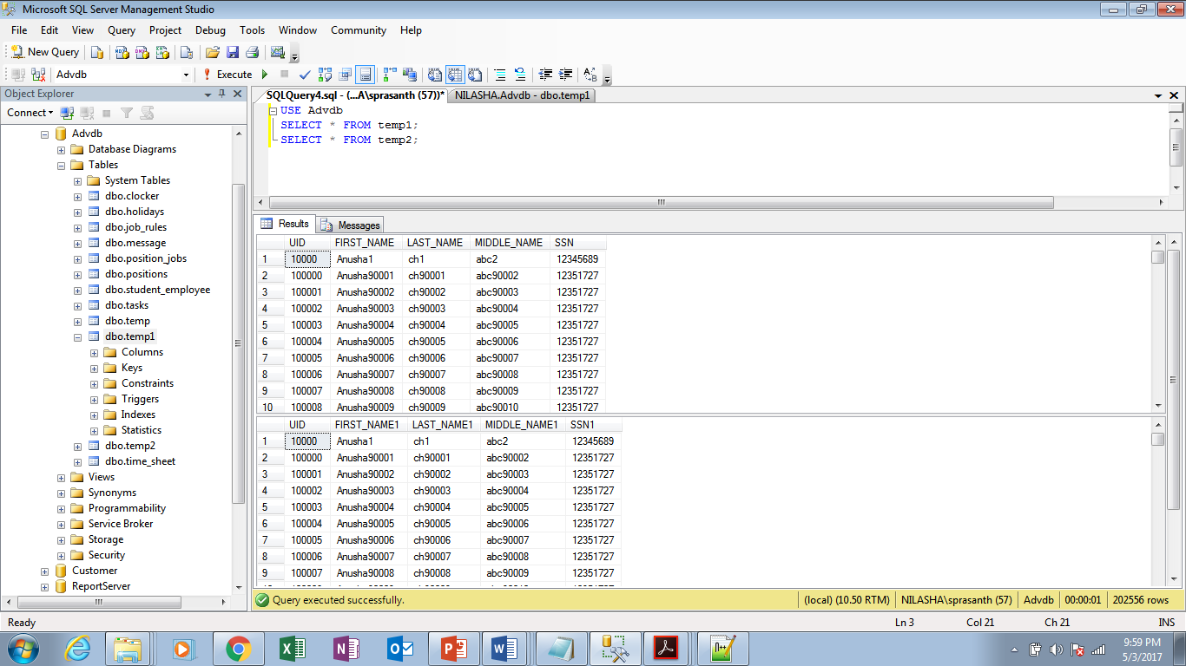
Two Sample Tables:

Slide 10
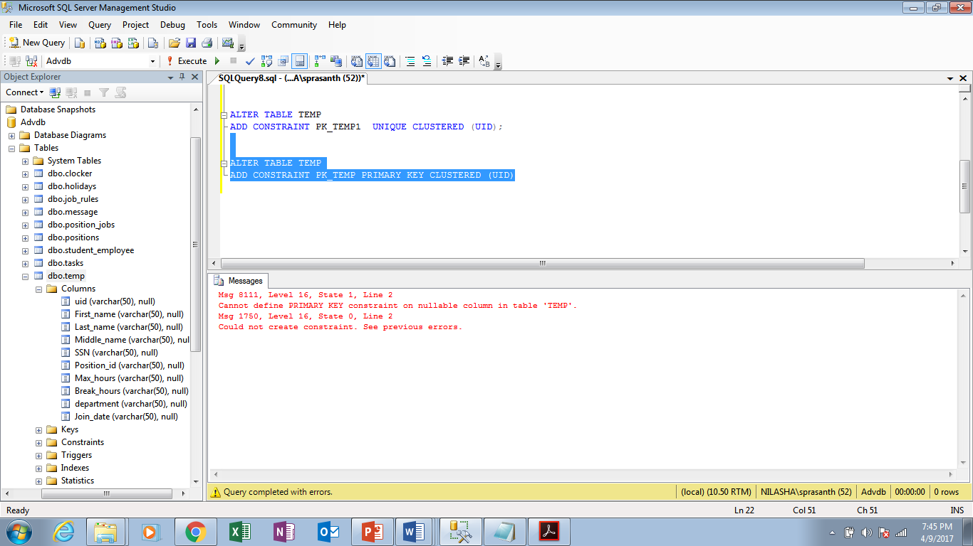
Giving Primary Key :

Slide 11
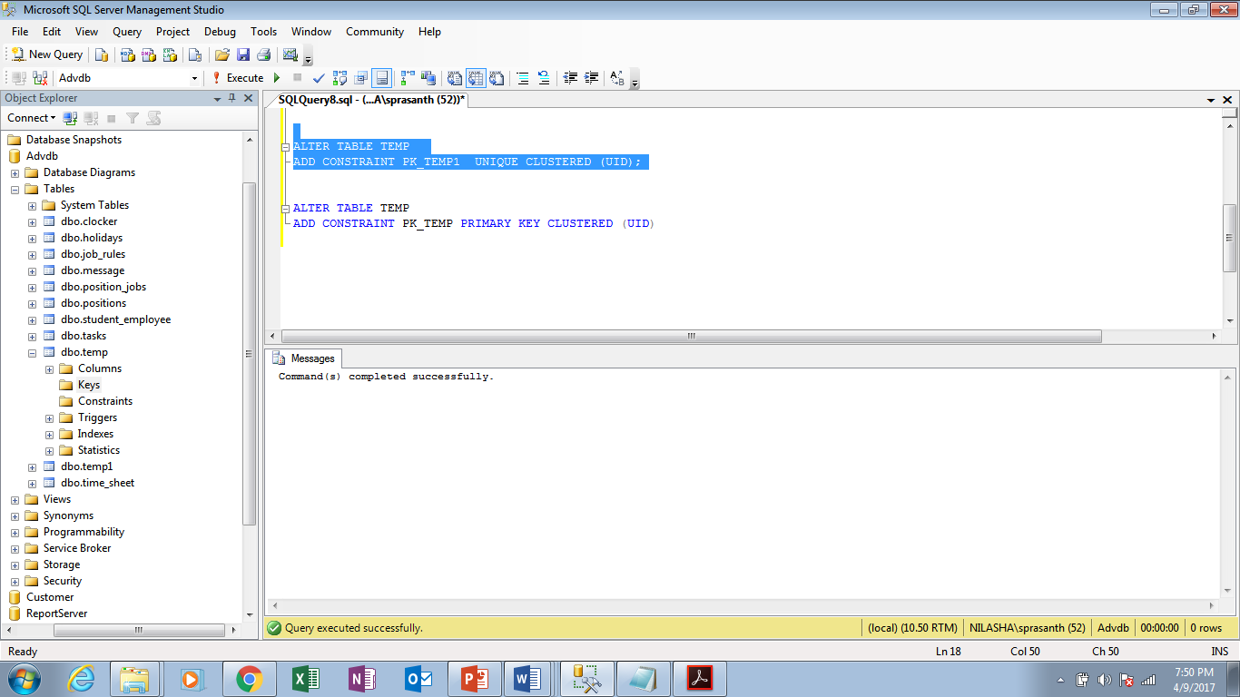

Slide 12
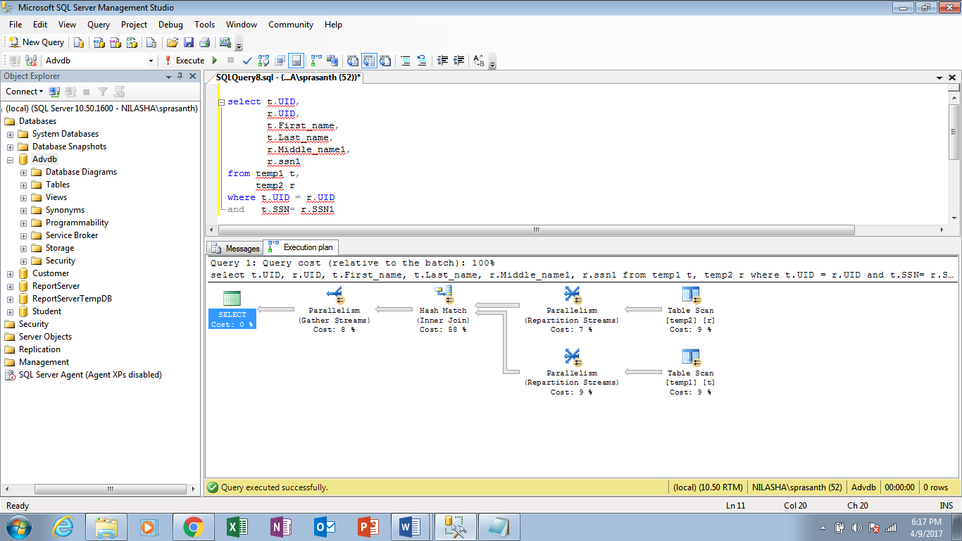
Execution Plan before applying Indexes:

Slide 13
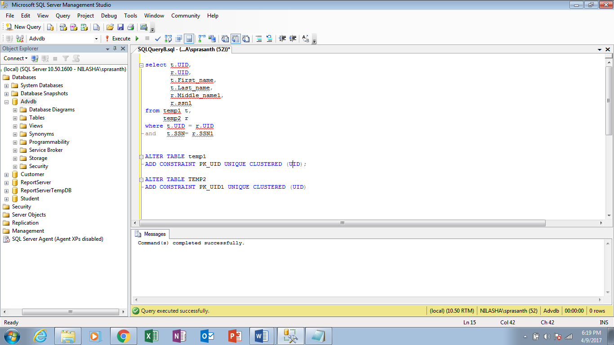
Applying Indexes:

Slide 14
Clustered Index :
A clustered index is a special type of index that reorders the way records in the table are physically stored. Therefore table can have only one clustered index. By default SQL Server takes primary key as clustered Index.
So we have created clustered index on the two tables that we have shown in the previous slide. In the below slide we can see the cost consumption on that particular table.
Merge Join :
Merge join is possible for the tables have an index on the join column. The index either clustered or covering non-clustered index.
After applying clustered index on the above two tables it will take merge join instead of Hash join.

Slide 15
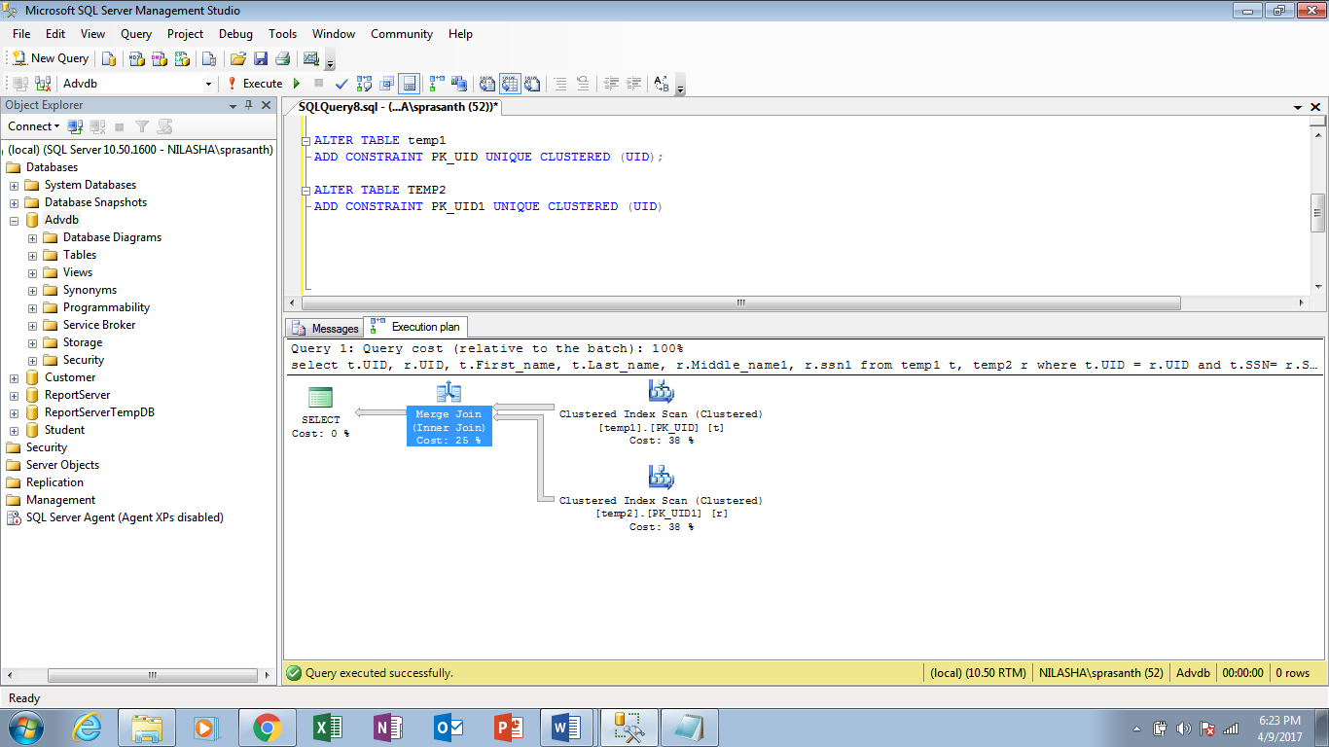
Execution Plan After applying Indexes:

Slide 16
Query Performance
Joins
Nested Loop Join
Hash Join
Sort Merge
Star Transformation

Slide 17
Fine Tuning (Hints)
use_nl(tab)
use_nl_with_index(tab,indx)
use_hash(tab)
Ordered
index(tab, indx)
no_index(tab,indx)

Slide 18
Joins
HASH JOIN: -
Hash joins is possible for tables with no index (or) either of the big tables has indexed. It’s best join for this circumstance. Why it’s best join? Because it’s worked great for big tables with no index and run the query parallel (more than one processor) and give the best performance. Most of folk says its heavy lifter join.
NESTED LOOP JOIN: -
Nested loop join is possible for small tables with index (or) either of the big tables have indexed. It’s best join for this circumstance. Why it’s best join? Because it works great for small tables like, compares each row from one table to each row from the other table ‘looping’.

Slide 19


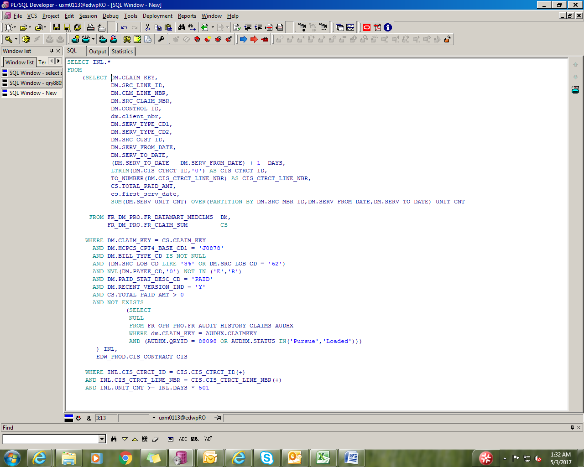

Real time Query Example :

Slide 20
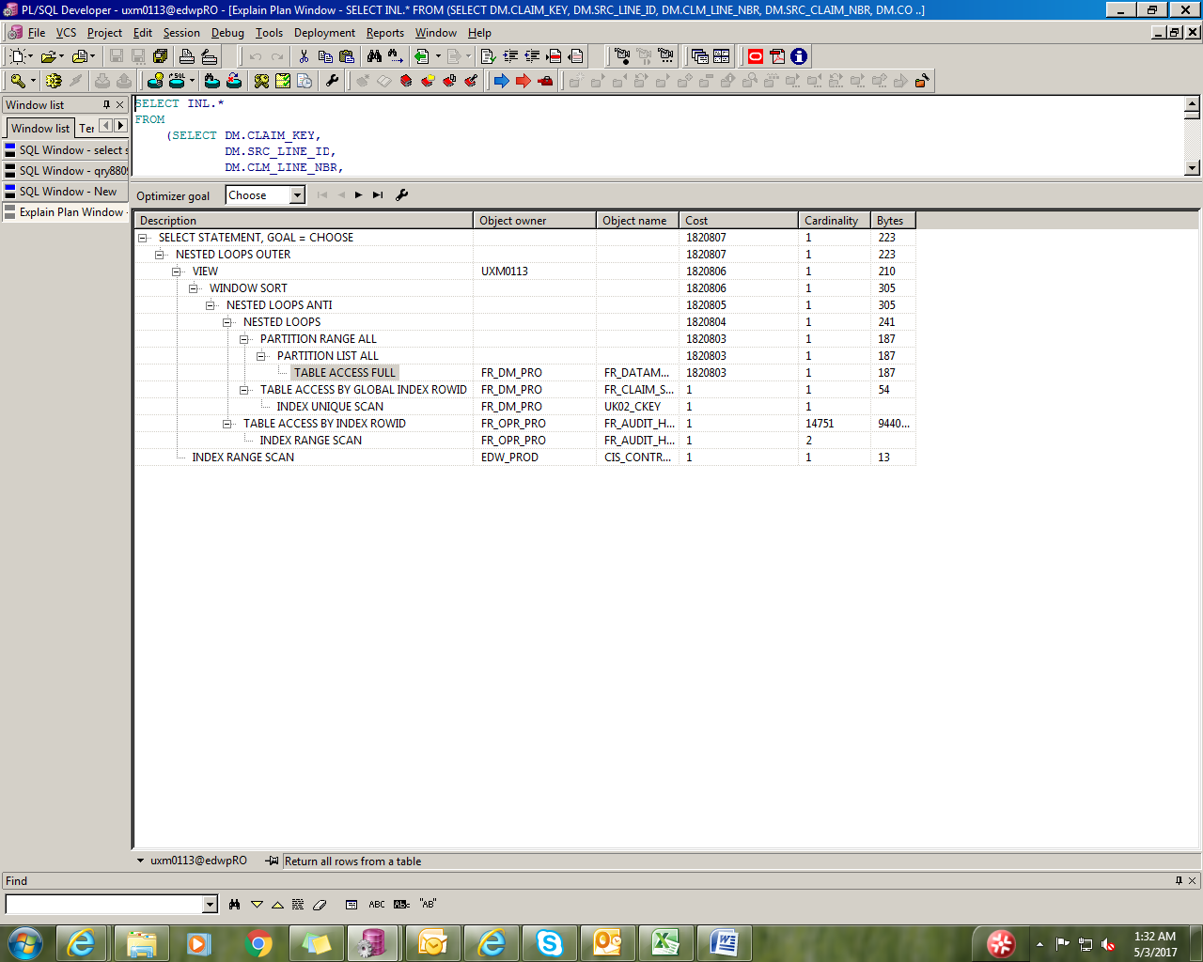
With Out Index

Slide 21
Analysed tables in real time scenario with applying all the indexes and joins. Checked Query optimization by giving Hash join
and Merge Join and nested loop Join to analyse the cost optimization.
Sql Statements are used to retrieve data from the database. We can get same results by writing different sql queries. But use of the best query is important when performance is considered. So you need to sql query tuning based on the requirement. Here is the list of queries which we use regularly and how these sql queries can be optimized for better performance.

Slide 22
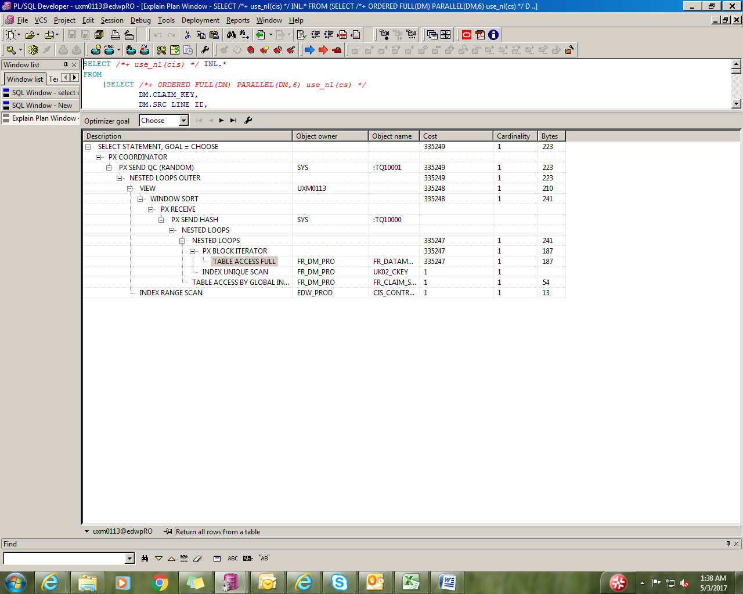
After Indexes

Slide 23
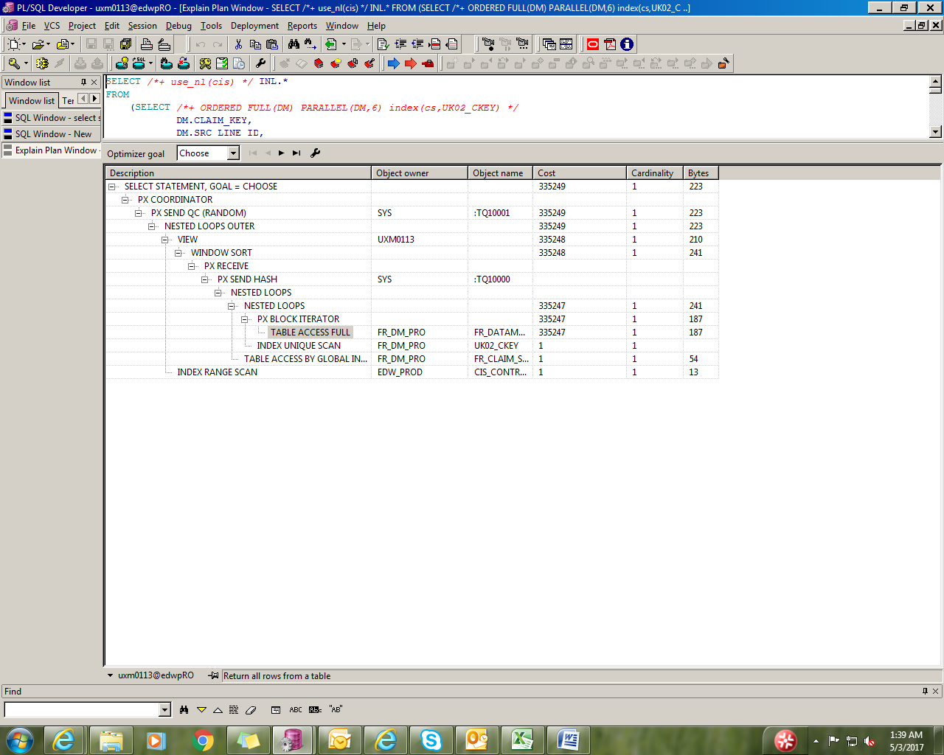
Force index using index(tablename, index name):

Slide 24

Using Use_hash

Slide 25
Conclusion
We Reduced Query Cost by verifying Query Optimization and fine tuning techniques.
Analysed few tables by applying all types of indexes and joins and verified how it works with Data.
Executed and Validated all the required Test cases.

Slide 26
Thank You
CS5600 Advance Database Management System
Spring 2017
Anusha Chanumolu
Lalitha Madhuri Putachala
Srividya Gundarapu

